Slide 1
Ai-Powered Nutrition Analyzer For Fitness Enthusiasts TEAM ID: PNT2022TMID23094
Team Leader:
N.Gayathri
A.Varshini
S.Vijayalakshmi
S.Karthika
Mentor :
Dr. R.Vijayalakshmi

Slide 2
Problem Definition
Food is essential for human life and has been the concern of many healthcare conventions. Nowadays new dietary assessment and nutrition analysis tools enable more opportunities to help people understand their daily eating habits, exploring nutrition patterns and maintain a healthy diet. Nutritional analysis is the process of determining the nutritional content of food. It is a vital part of analytical chemistry that provides information about the chemical composition, processing, quality control and contamination of food.
The main aim of the project is to building a model which is used for classifying the fruit depends on the different characteristics like colour, shape, texture etc. Here the user can capture the images of different fruits and then the image will be sent the trained model. The model analyses the image and detect the nutrition based on the fruits like (Sugar, Fibre, Protein, Calories, etc.).

Slide 3
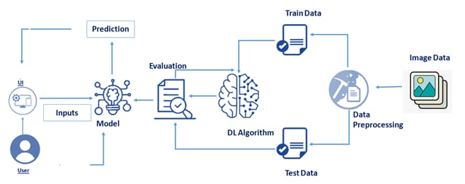
Technical Architecture

Slide 4
Paper-1
Author: Edler A.H.Apka,Masashi Fujiwra,Yutaka Arakawa,Hirohiko Suwa ,Keiichi Yasumoto
Title: Glove for indoor fitness tracking system
Published Journal: 2018 IEEE International Conference on Pervasive Computing and Communications Workshops (PerCom Workshops)
Year of Published: 19-23 March 2018
Objective:. It has been intensively demonstrated that physical activity can enhance the mental and physical health of practitioners. In recent years, fitness activities became the most common way to engage in physical activities. In this paper, we propose a smart-glove based fitness activity tracking system that can detect athletes activities in any indoor fitness facility, with no need of attaching multiple sensors on the athlete's body.
Technology used: Artificial Intelligence

Slide 5
Paper-2
Author: Asia Flores , Brandon Hall , Luke Carter , Maxwell Lanum , Rishi Narahari , Garrett Goodman
Title: Verum Fitness: An AI Powered Mobile Fitness Safety and Improvement Application
Published Journal: 2021 IEEE 33rd International Conference on Tools with Artificial Intelligence (ICTAI)
Year of published: 01-03 November 2021
Objective: At home fitness has rapidly risen recently due to the COVID-19 pandemic and stay-at-home-orders. This also produced a large set of first time users of gym equipment and structured exercise routines
Technology used: Artificial intelligent

Slide 6
Paper-3
Author : Ya Lu , Thomai Stathopoulou , Maria F. Vasiloglou , Stergios Christodoulidis
Title : An Artificial Intelligence-Based System for Nutrient Intake Assessment of Hospitalised Patients
Published Journal : 2019 41st Annual International Conference of the IEEE Engineering in Medicine and Biology Society (EMBC)
Year of published : 23-27 July 2019
Objective: Regular nutrient intake monitoring in hospitalised patients plays a critical role in reducing the risk of disease-related malnutrition (DRM)
Technology used : Artificial Intelligence

Slide 7
Paper-4
Author : Gourangi Taware , Rohit Agrawal , Pratik Dhende , Prathamesh Jondhalekar, Shailesh Hule
Title : AI-based Workout Assistant and Fitness guide
Published Journal : 2022 IEEE 7th International conference for Convergence in Technology (I2CT)
Year of published : 06-12-2021
Objective : This is an application that detects the users exercise pose counts the specified exercise repetitions and provides personalized, detailed recommendations on how the user can improve their form.
Technology used : Artificial Intelligent

Slide 8
Paper-5
Author: Chang Liu, Yu Cao, Senior Member, IEEE, Yan Luo, Member, IEEE, Guanling Chen, Member,
IEEE, Vinod Vokkarane, Senior Member, IEEE, Yunsheng Ma, Songqing Chen, Member, IEEE
Title: A New Deep Learning-based Food Recognition System for Dietary Assessment on An Edge Computing Service Infrastructure
Published Journal: 2019 IEEE Explainability for artificial intelligence in healthcare
Year of Published: 15 September 2021
Objective: In this review, we provide an overview of the main and latest applications of AI in nutrition research and identify gaps to address to potentialize this emerging field. AI algorithms may help better understand and predict the complex and non-linear interactions between nutrition-related data and health outcomes
Technology used: Artificial intelligent

Slide 9
Critical Findings:
The application can be flexible in terms of timing according to their schedule
The human-technology interface, through which the micro- (behavioral) and macro- (social) aspects converge, still calls for extensive examination
Hopefully the identified approach can lead to producing effective diet applications that provide many benefits and can be applied for prolonged use

Slide 10
Thank You!

